Slide 1
Representational State Transfer (REST)
Applications to Science Gateways

Slide 2
State in Distributed Systems
Managing state in a distributed is a challenging problem
Log-centric architectures are a popular way to manage state replication
Logs are records of state, not logging messages
Kafka, Zookeeper internals
Next lecture: the Raft protocol
States in gateways:
Job status changes, file transfers, workflows
States (logs) should be a first-class design consideration
Two types of state to consider
State within gateway components
State between a gateway and external clients

Slide 3
Application Manager
Application Manager
Application Manager
Message Broker
Client
API Server
Orchestrator
REST, HTTPS
API Server
Orchestrator
API Server
Orchestrator
Registry
Registry
Registry

Slide 4
State in Client-Server Systems
Stateless servers:
Do no keep information on the state of the interaction with clients.
Idempotent: sending the same request multiple times gives the same result as just sending once.
Server states can change without communicating this to clients.
Someone else bought the last plane ticket
Stateful servers
Maintain information on the clients
”Conversation”
Failure recovery can be complicated
HTTP and REST use stateless servers
But state for the system has to be somewhere

Slide 5
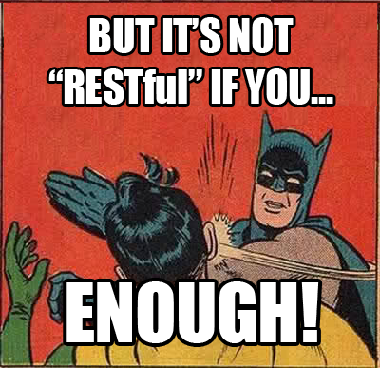
This Is Not a REST Tutorial
You can find lots of tutorial by searching.
REST is an architectural style, not a protocol, so you may find conflicting discussions on some fine (and not so fine) points.
There are good ways and bad ways to implement REST architecture.
REST has some shortcomings, so make informed choices.

Slide 6
What Is REST? Consider Web browsers
Web browsers have the state.
The user picks what she/he wants to do next based on links.
The HTML in the browser is the state of the dialog between the user and the Web server.
The server doesn’t maintain any state about this dialog.
REST extends these ideas to machine-to-machine communication

Slide 7
From the Source: Roy Fielding
"Representational State Transfer is intended to evoke an image of how a well-designed Web application behaves: a network of web pages (a virtual state-machine), where the user progresses through an application by selecting links (state transitions), resulting in the next page (representing the next state of the application) being transferred to the user and rendered for their use."
Fielding, Roy Thomas. "Architectural styles and the design of network-based software architectures." PhD diss., University of California, Irvine, 2000.

Slide 8
In Other Words…
REST is a generalization of the way the Web works
Generalize this for machine-to-machine.

Slide 9
Features of the HTTP Protocol in REST
HTTP official specifications
https://tools.ietf.org/html/rfc2616
Request-Response
Uses URLs to identify and address resources.
Stateless (but extendable)
Limited set of operations
GET, PUT, POST, DELETE, HEAD, ...
Transfers hypermedia in the body
HTML, XML, JSON, RSS, Atom, etc.
Extendable by modifying its header
Security, etc.
Point to point security
TLS: transport level
Well defined error codes

Slide 10
https://trafficserver.readthedocs.org/en/stable/_images/http_headers.jpg

Slide 11
REST and HTTP
HTTP is a formally specified protocol for network interactions.
REST is an architectural style that uses HTTP.
Because the Web scales
“Architectural style”
Art + technical skill
The art of REST is to define APIs using HTTP that are beautiful and elegant as well as useful.

Slide 12
REST and HTTP
In REST, HTTP operations are VERBS.
There are only ~4 verbs.
URLs are NOUNS
Don’t have API methods like “/getUserID”, “/updateUserID”.
Why not?
VERBS act on NOUNS and may change resource state.
Client states are contained in the response message.
Resource states are maintained by the server

Slide 14
URL Patterns for REST Services
Designing good URLs for REST services is an art.
Bad design will still work
Leads to insidious technical debt: you need your API to be understandable and consistent
Best practice is to use structured, not flat URLs.
Remember to make them nouns.
Think of your resources as collections
Experiments and their subcomponents, computing resources, applications,
More importantly, have the right abstraction API
Define your resources first
Specific URLs may change.
HATEOAS
Are any gateway operations not covered by GET, PUT, POST, DELETE?

Slide 15
Status Codes and Errors
REST services return HTTP status codes.
Remember that APIs are used by external developers
So return the right codes.
200’s: everything is OK
400’s: client errors: malformed request, security errors, wrong URLs
500’s: server errors: processing errors, proxy errors, etc
Error codes are machine parse-able.
HTTP doesn’t have application specific errors for your service.
Include helpful information on why the error occurred.
Challenge to make this machine parse-able.
Compare with exceptions and try-catch blocks in RPC-ish methods

Slide 16
Some REST Advantages
Leverage 25 years of HTTP investments
Security, extensibility, popularity
Low entry barrier to get people to try your service
Use curl command to try things out
Message format independent
Like JSON? Use JSON
Like XML? Use XML
Like CSV?

Slide 17
REST Challenges
Data models for your messages are application specific
Need to pick a language (JSON, etc)
Types are language-dependent
Changing message formats will break services.
Message formats are validated by the service implementation, not at the message transport level
Versioning is informal
Every REST implementation comes up with its own strategy.
Backward-forward compatibility of different versions is a challenge
Programmatic error catching is hard
No equivalent to Java exceptions
Everything is an HTTP error code plus some conventional text
Compare this to Apache Thrift

Slide 18
Hypermedia as the Engine of Application State
HATEOAS
http://roy.gbiv.com/untangled/2008/rest-apis-must-be-hypertext-driven

Slide 19
You Are Doing It Completely Wrong
REST APIs evolve.
You add new features.
You change the message formats
You change the URL patterns
This breaks RPC-ish clients.
Maintaining backward compatibility for legacy clients gets harder over time
HATEOAS is a “design pattern” to prevent this problem.
Keep your clients and server loosely coupled
Part of Fielding’s original REST conception that is frequently overlooked.

Slide 20
H is for Hypermedia
Main idea of HATEOAS: REST services return hypermedia responses.
Hypermedia is just a document with links to other documents.
In ”proper” REST, hypermedia documents contain links to what the client can do.
Semantics of the API need to be understood and defined up front.
Specific details (links that enable specific actions) can change
Change can occur over different time scales
Resource state changes (think: buying an airplane ticket)
Service version changes

Slide 21
HATEOAS in Brief
Responses return documents consisting of links.
Use links that contain “rel”,“href”, and “type” or equivalent.
The specific links in a specific message depend on the current state of the dialog between client and server.
Not every message contains all of your rels.
Attribute | Description
Rel | This is an API method. You should have persistent, consistent “rels” for all your API methods.
Href | This is the URL that points to the “rel” noun in a specific interaction.
Type | This is the format used in the communications with the href. Many standard types (”text/html”). Custom types should follow standard conventions for naming

Slide 22
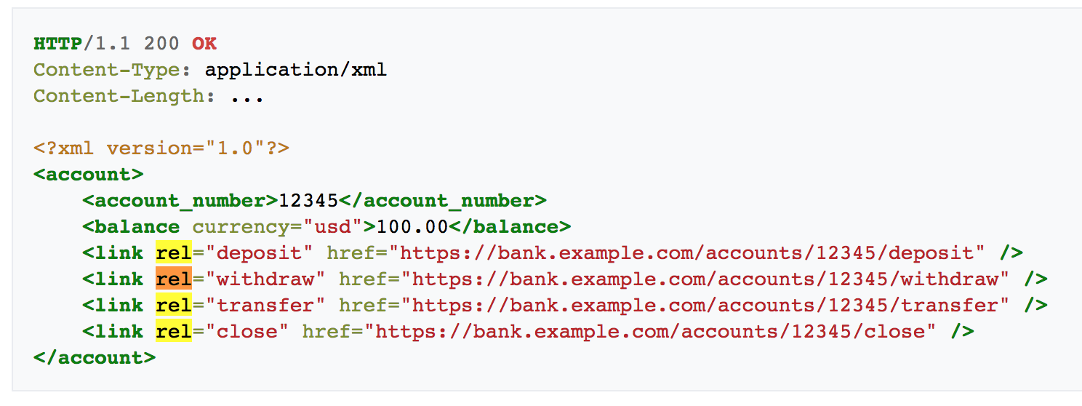
The RELs define the general API methods available to you for your next operation, and the URLs provide specific resources that you can operate on. Note the HTTP verbs are not specified, and you are not told what format to send your message. Also, it would be better to use URIs for your rels instead of English verbs.
https://en.wikipedia.org/wiki/HATEOAS

Slide 23
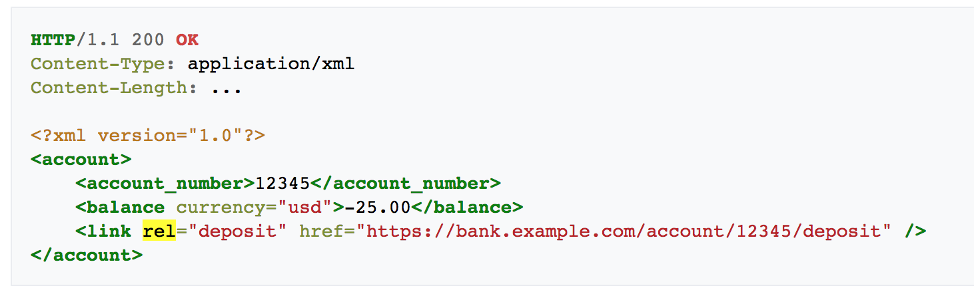
HATEOS in action: the same request can give a different response with different possible future actions if you have overdrawn your account.

Slide 24
http://www.slideshare.net/josdirksen/rest-from-get-to-hateoas

Slide 25
JSON, XML, HTML, and HATEOAS
What’s the best language for HATEOAS messages?
JSON: you’ll need to define “link” because JSON doesn’t have it.
XML:
Extensions like XLINK, RSS and Atom are also have ways of expressing the “link” concepts directly.
Time concepts built into RSS and Atom also: use to express state machine evolution.
HTML: REST is based on observations of how the Web works, so HTML obviously has what you need.

Slide 26
The OpenAPI Specification and Swagger
Using REST to describe REST services

Slide 27
REST Description Languages
General problem to solve: REST services need to be discoverable and understandable by both humans and machines.
“Self Describing”
API developers and users are decoupled.
There are a lot of attempts: https://en.wikipedia.org/wiki/Overview_of_RESTful_API_Description_Languages

Slide 28
Real problem #1: humans choose APIs, but then the APIs evolve, endpoints change, etc.

Slide 29
Examples of Real Problem #1
You add a new API method
You change the way an old API method works.
You change the inputs and outputs
You want to add some error handling hints associated with the API
You change API end points.
HATEOAS may help with some of this.

Slide 30
Real problem #2: Data models are out of scope for REST

Slide 31
More about Real Problem #2
Science gateway data model examples
Computing and data resources, applications, user experiments
Data models can be complicated to code up so every client has a local library to do this.
Data models evolve and break clients.
HATEOAS types in data models depend on data model language (JSON, XML, etc).

Slide 32
Usual solution is to create an SDK wrapper around the API.
Helps users use the API correctly, validate data against data models, etc.

Slide 33
Swagger -> OpenAPI Initiatve, or OAI
OAI helps automate SDK creation for REST services
Swagger was a specification for describing REST services
Swagger is tools for implementing the specification
OpenAPI Initiative spins off the specification part
OAI is openly governed, part of the Linux Foundation, available from GitHub
https://github.com/OAI/OpenAPI-Specification

Slide 34
OAI Goals
Define a standard, language-agnostic interface to REST APIs
Allow both humans and computers to discover and understand the capabilities of the service without access to source code, documentation, or through network traffic inspection.
When properly defined, a consumer can understand and interact with the remote service with a minimal amount of implementation logic.
Similar to what interfaces have done for lower-level programming, Swagger removes the guesswork in calling the service.
http://swagger.io/introducing-the-open-api-initiative/

Slide 35
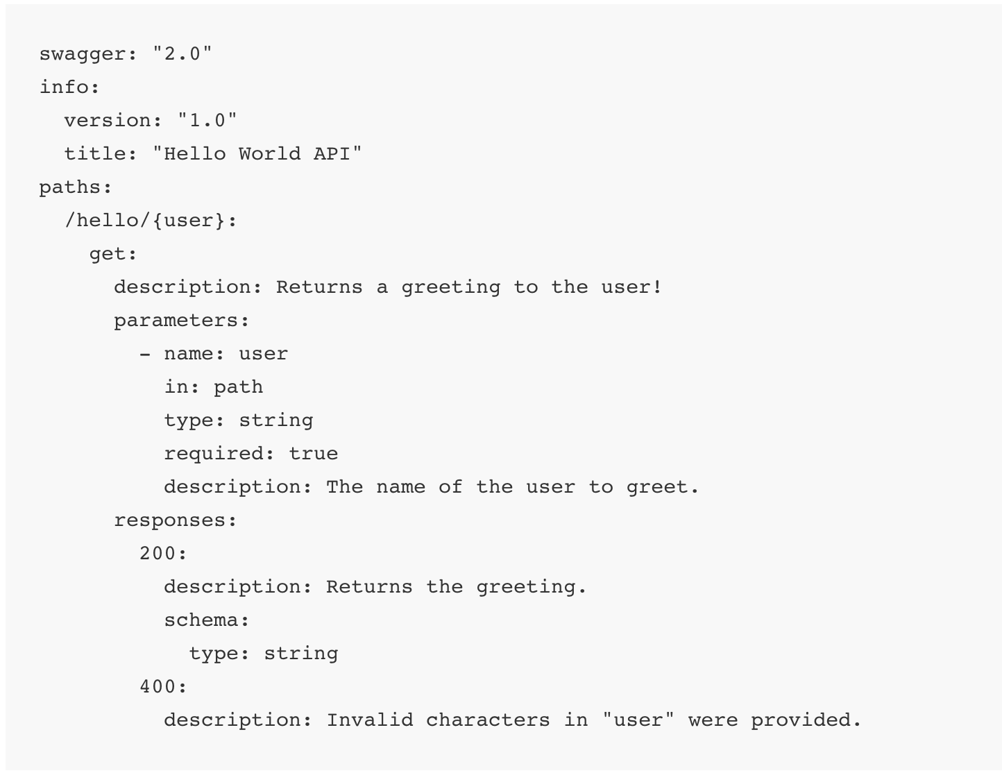
”Hello World!” in OAI
More examples:
https://github.com/OAI/OpenAPI-Specification/tree/master/examples/v2.0/json
http://swagger.io/getting-started-with-swagger-i-what-is-swagger/

Slide 36

Swagger Tools
http://swagger.io/tools/

Slide 37
Creating OAI Definitions
Top Down: You Don’t Have an API
Use the Swagger Editor to create your Swagger definition
Use the integrated Swagger Codegen tools to generate server implementation.
Bottom Up: You Already Have an API
Create the definition manually using the same Swagger Editor, OR
Automatically generate the Swagger definition from your API
Supported frameworks: JAX-RS, node.js, etc
My advice: be careful with automatically generated code.

Slide 38
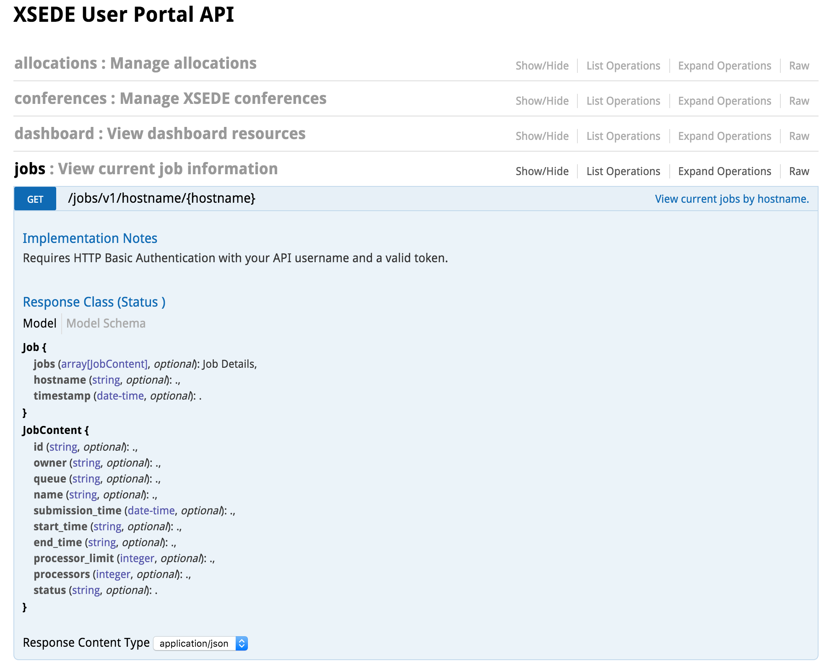
Swagger and the XSEDE User Portal
https://portal.xsede.org/
https://api.xsede.org/swagger/

Slide 39
REST and Science Gateways
Applying to Science Gateways

Slide 40
REST and Science Gateways
Your actions are already defined: GET, PUT, POST, DELETE
Define your nouns and noun collections: you need to get this right
Computing resources: static information and states
Applications: global information about a specific scientific application
Application interfaces: resource specific information about an application
Users
User experiments: static information and states
Define data models for your nouns
You will get this wrong, but don’t worry
Define the operation patterns on your nouns
Composed of request-response atomic interactions
You need to specify your HATEOAS hypermedia formats
Your operation patterns map to these.

Slide 41
Is REST appropriate for microservice systems?
Assumptions: you have a lot of microservices, each service may maintain redundant versions for load balancing, and services come and go.

Slide 42
Application Manager
Application Manager
Application Manager
Message Broker
Client
API Server
Orchestrator
REST, HTTPS
API Server
Orchestrator
API Server
Orchestrator
Registry
Registry
Registry

Slide 43
Comparison of REST and Microservices
REST over HTTP
Gateway Microservices
Request-response
Synchronous
URLs must be resolvable
Server determines possible future states
Client picks the next state it wants
Internal server state changes are hidden
Fault recovery, elasticity, etc are not inherent considerations
Work well with push messaging, queues, many-to-many messaging
Asynchronous
State manager (orchestrator) decides what should be done next
Orchestrator needs to be notified by external state changes
Fault recovery, elasticity, etc are first class considerations

